Slide 1
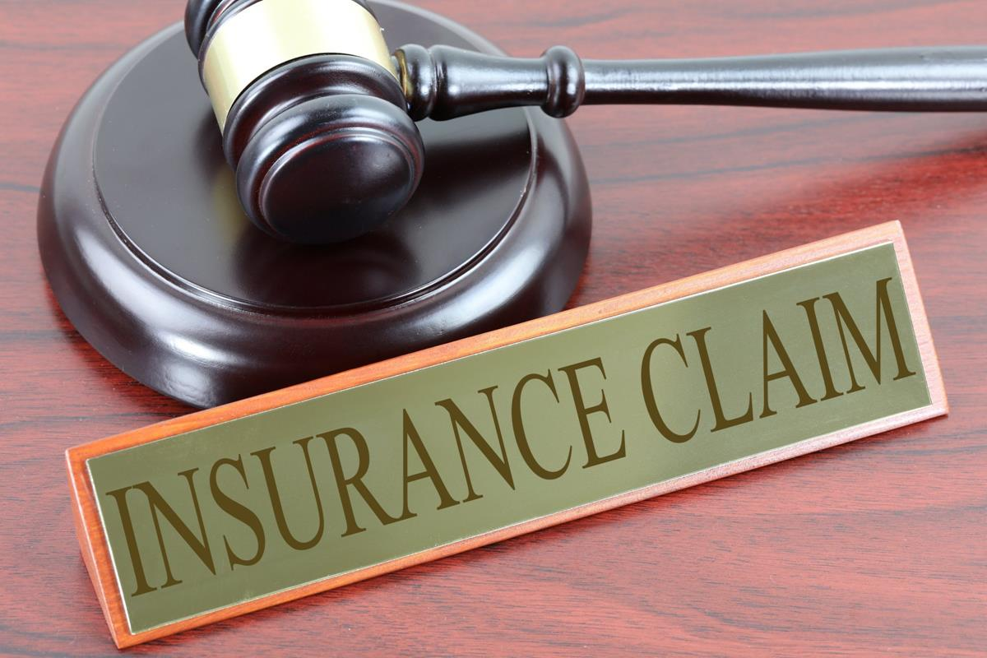
Auto Insurance Claim Fraud
Capstone Project
Created by : Rachna Nathan

Slide 2

Name – Rachna Nathan
Carry 10 years of experience in customer service area.
Aspiring Data analyst / data scientist
https://www.linkedin.com/in/rachna-nathan-20756b95/

Slide 3

Content
Background
Business Question
Data Sources
Data Processing
EDA Analysis
Questions ???????????

Slide 4
Background
Insurance fraud is any act committed to defraud an insurance process.
It occurs when a claimant attempts to obtain some benefit or advantage they are not entitled to, or when an insurer knowingly denies some benefit that is due
Car insurance, health insurance and property insurance are some of the main where most of the fraud claims are attempted.
Faking deaths, collision or car theft to collect insurance money are some examples. Sometimes people also go as far as falsifying a police report to use their claim.
Insurance fraud impacts consumers by adding extras fees and the cost of consumer good and services. It also leads insurance companies to denying benefit that is due.

Slide 5

Insurance fraud trends in Aotearoa New Zealand
In Aotearoa New Zealand, we are still working towards closer collaboration between insurers on fraud matters.
This will ensure we share information about insurance fraud issues and trends and maintain important resources such as our Insurance Claims Register.
The Insurance Claims Register (ICR) detects and prevents fraud, particularly purposeful non-disclosure and double dipping at claim time.
Unfortunately, the old adage of 'utmost good faith' is no longer working.
Fraud is costing honest policyholders hundreds of millions of dollars every year.
Current estimates suggest between 5% and 10% of claims are fraudulent.

Slide 6

INSURANCE FRAUD TRENDS IN THE USA
Over in the US, 2021 was a year where vehicle theft and fraudulent claims remained high, with personal Auto insurance fraud continuing to increase. Fraudulent prior loss and damage claims (e.g. for vehicles and houses) also continued to increase.
US fraud trends that we should be looking out for globally include:
Ghost brokers – the selling of forged or invalid insurance policies to consumers
Bash and buy – breaking or damaging something then negotiating a heavily discounted price because of the damage
Illegal use of temporary licence plates on motor vehicles
Builders risk insurance delayed reporting – claims relating to delayed construction work
Ransomware attacks – malware that denies access to files on a user’s computer
Identity fraud – the theft of your online identity and financial information

Slide 7

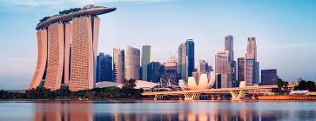
INSURANCE FRAUD TRENDS IN UK
UK Vehicle Fraud numbers, 2020: detected motor frauds fell by 6% to 55,000, while their value fell by only 1% to £602 million. Detection rates rose though (up 1.31 percentage points to 6%).
UK Travel Insurance numbers, 2020: there were 770 detected scams, down 49%. Travel insurance scam value, at £1.8 million, was a 2% increase on 2019, and the highest recorded average claims value of £2,358.
INSURANCE FRAUD TRENDS IN SINGAPORE
In Singapore, a tripling of historically low insurance fraud rates between 2018 and 2020 has seen the local Police Force work closely with the General Insurance Association of Singapore to better investigate and tackle increasing fraud rates. Health insurance claims were one of the key insurance products to see an increase in fraud.
Insurers also receive support from the Monetary Authority of Singapore, who ensure that stringent fraudulent risk management protocols are in place. With a jail time of three to ten years for convicted fraudsters, it seems that Singapore is doing all it can to reduce insurance fraud.

Slide 8
Business Question:
Can we able to predict the claim is fraud?
What characteristics of the claims are the best indicator of a potential fraud claim.

Slide 9
Data Source:
Fraud detection in insurance claim is retrieved from Kaggle:
https://www.kaggle.com/code/buntyshah/insurance-fraud-claims-detection/data
Dataset has 40 variables.
The variable for analysis:
Policy Number
Age
Gender
Incident Type
Policy report
*** Clink on the link above to see the remaining varaiables.

Slide 10

Data Pre-processing and Feature engineering
Load data to panda.
Outliers – Looked at the data and it was fine
Null Values – managed null values with the mean value.
Removed unwanted variables like the column C-39 which was empty.
Create a train and test data set

Slide 11
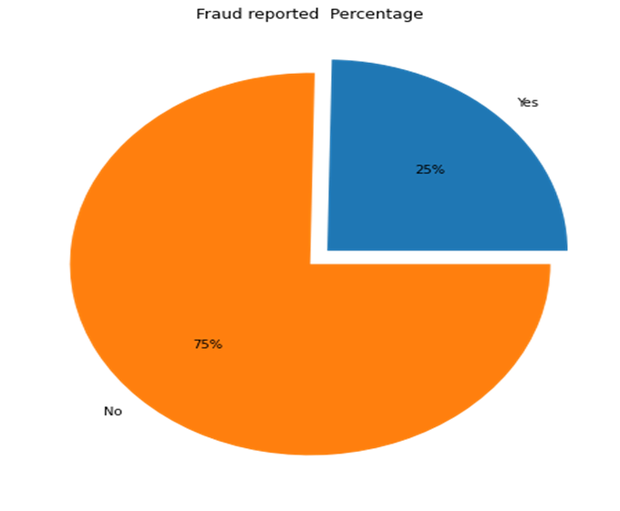
Exploratory data
The exploratory data started with the target variable fraud reported.
Fraud reported yes or No
"Yes" that is the insurance is fraudulent and "No" means the insurance claim is not fraudulent. Only 25% of the claim were reported fraud and the remaining 75% are not fraud.

Slide 12
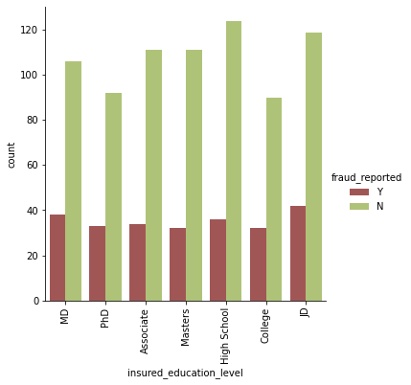
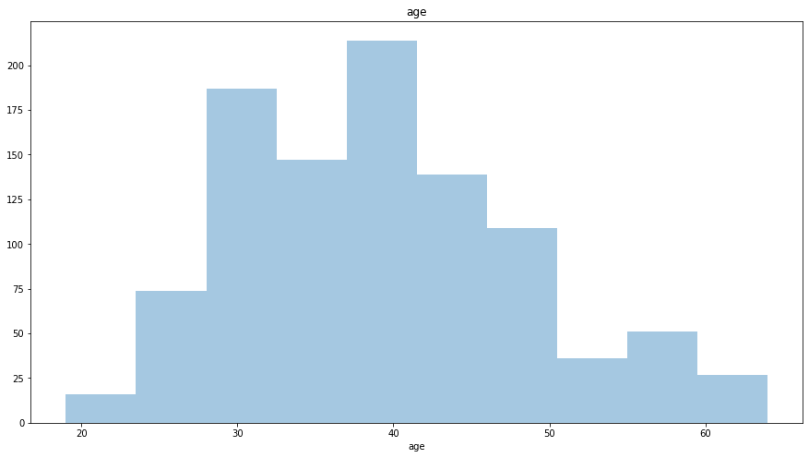
The below graphs throw some light on the education and the age of people with fraud claim. The education graphs show most of the fraud claim were done who have high school and JD education level. The age graph shows that the fraud claim were done between the age gap of 30 to 45

Slide 13
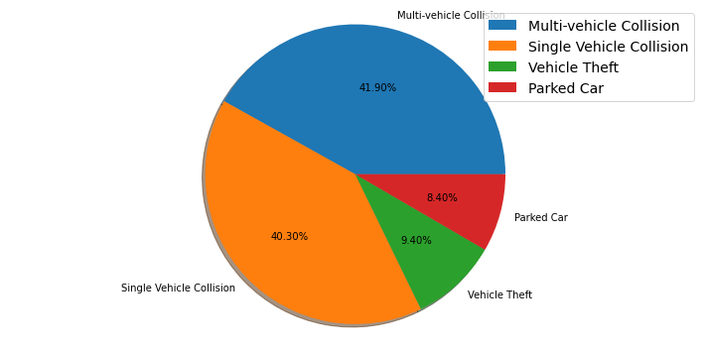
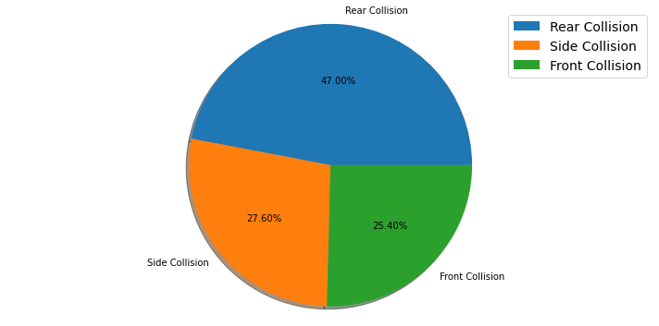

Slide 14
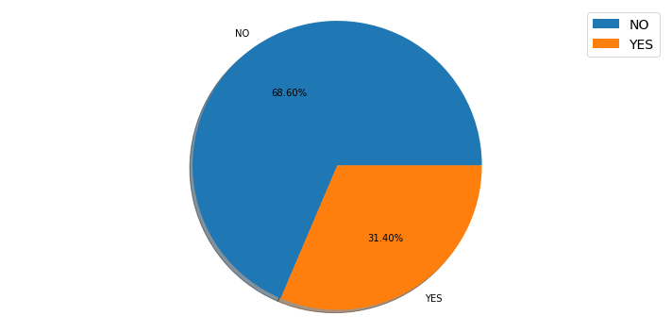

police_report_available
property_damage

Slide 15
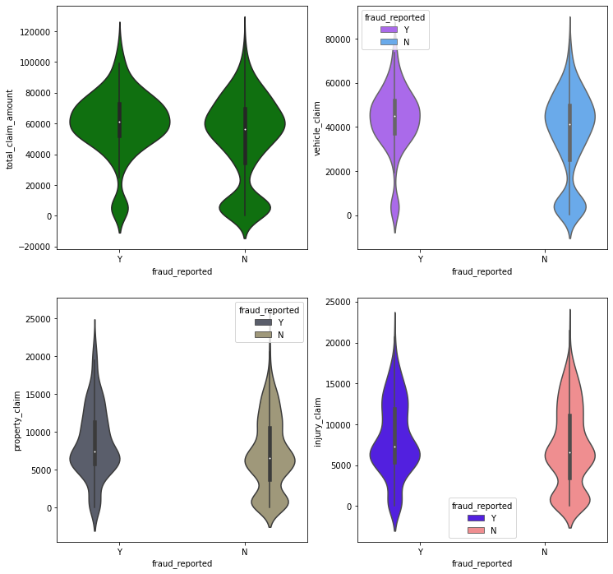

Slide 16
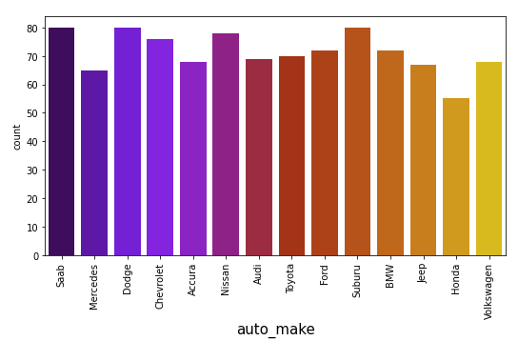

Slide 17
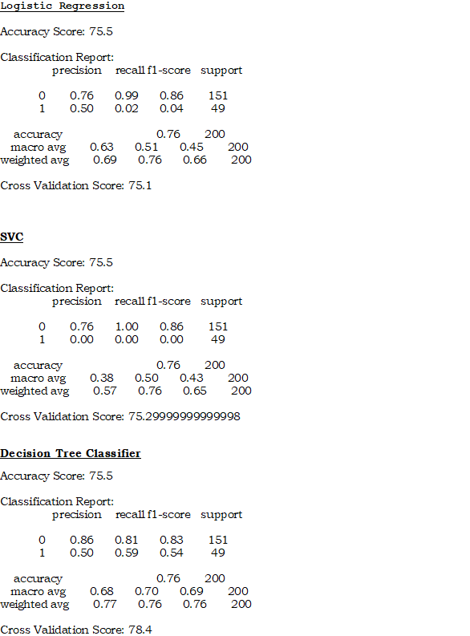
Split the dataset in train and test data set
Used several model to predict the fraud claim
Results

Slide 18
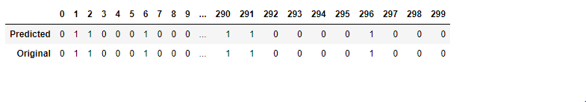
After hypertuning our cross validation score for decision tree has increased from 77.7% to 86.58%
Conclusion:-
The image shows that our model has perfectly fit and the conclusion shows that the original data vs the predicted data which is very similar.

Slide 19


